Slide 1
PYJAH Sprint 2
Project Manager: Ammanuel Getenet
Scrum master: Jeff au
Programmer one: Yang li
programmer two: Paul Ojo
Tester: Howie Huntington

Slide 2
What DOES THE PRODUCT DO?
It’s an application that uses Java to mirror an e-mail messaging system.
Features
The user interface is built using JavaFx which makes it very user friendly.
It will implement RSA encryption for the security of the users credential and the e-mail/messages that are being sent and received.
Platform
It will run on any system that has the JVM installed.

Slide 3
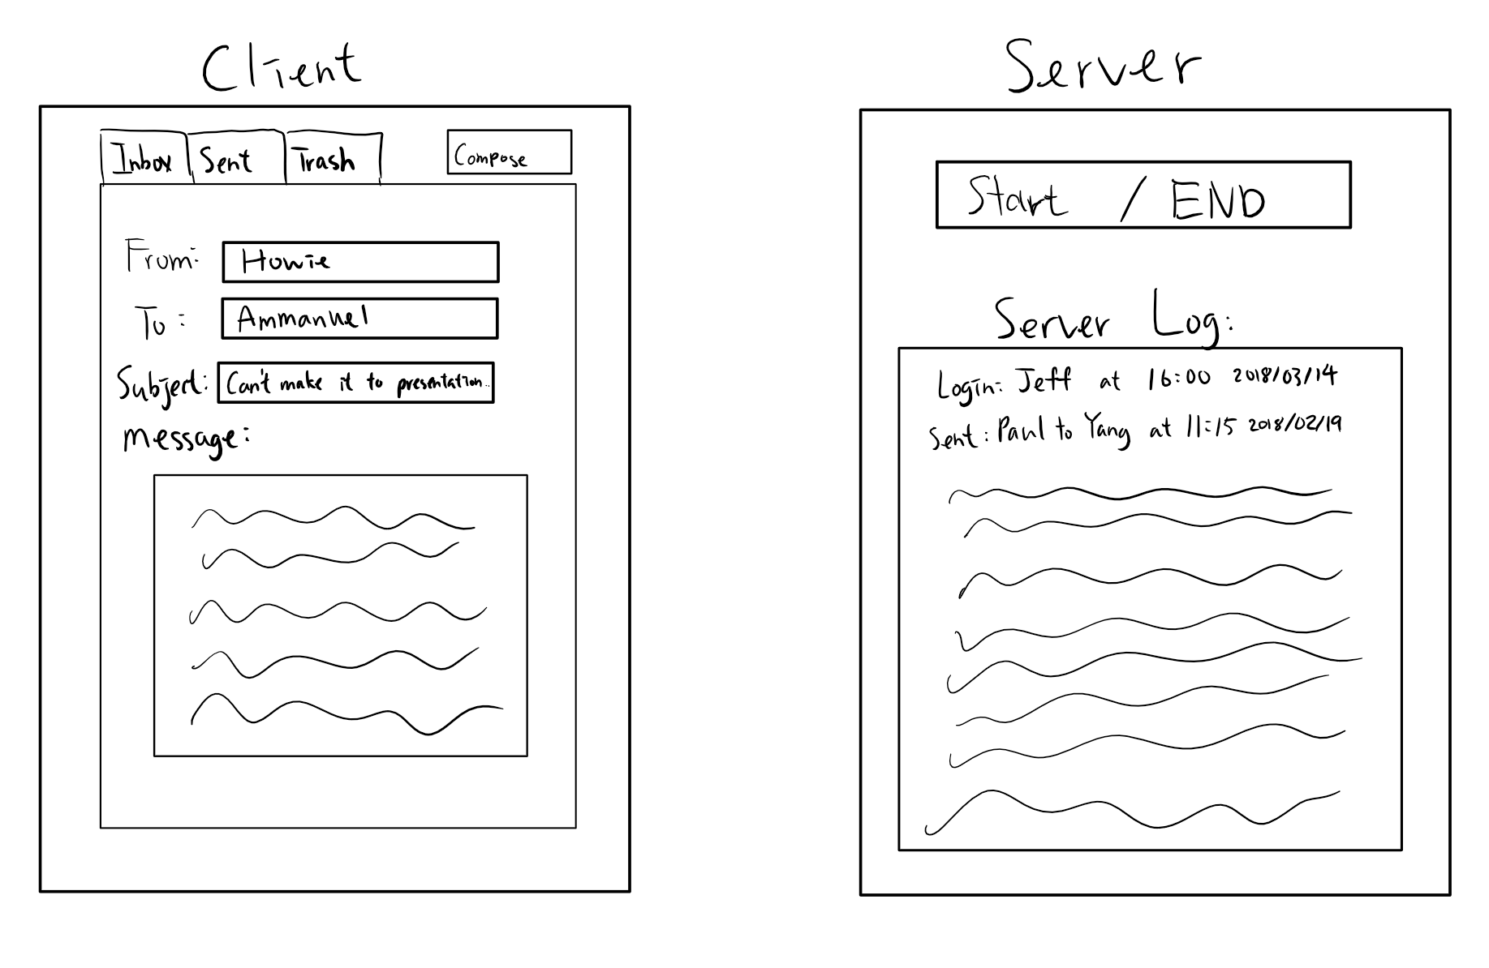
What it does?
It allows the user to connect to the server through the client program.
The server verifies the credentials and this is what the server and client GUI will look like once logged in.

Slide 4

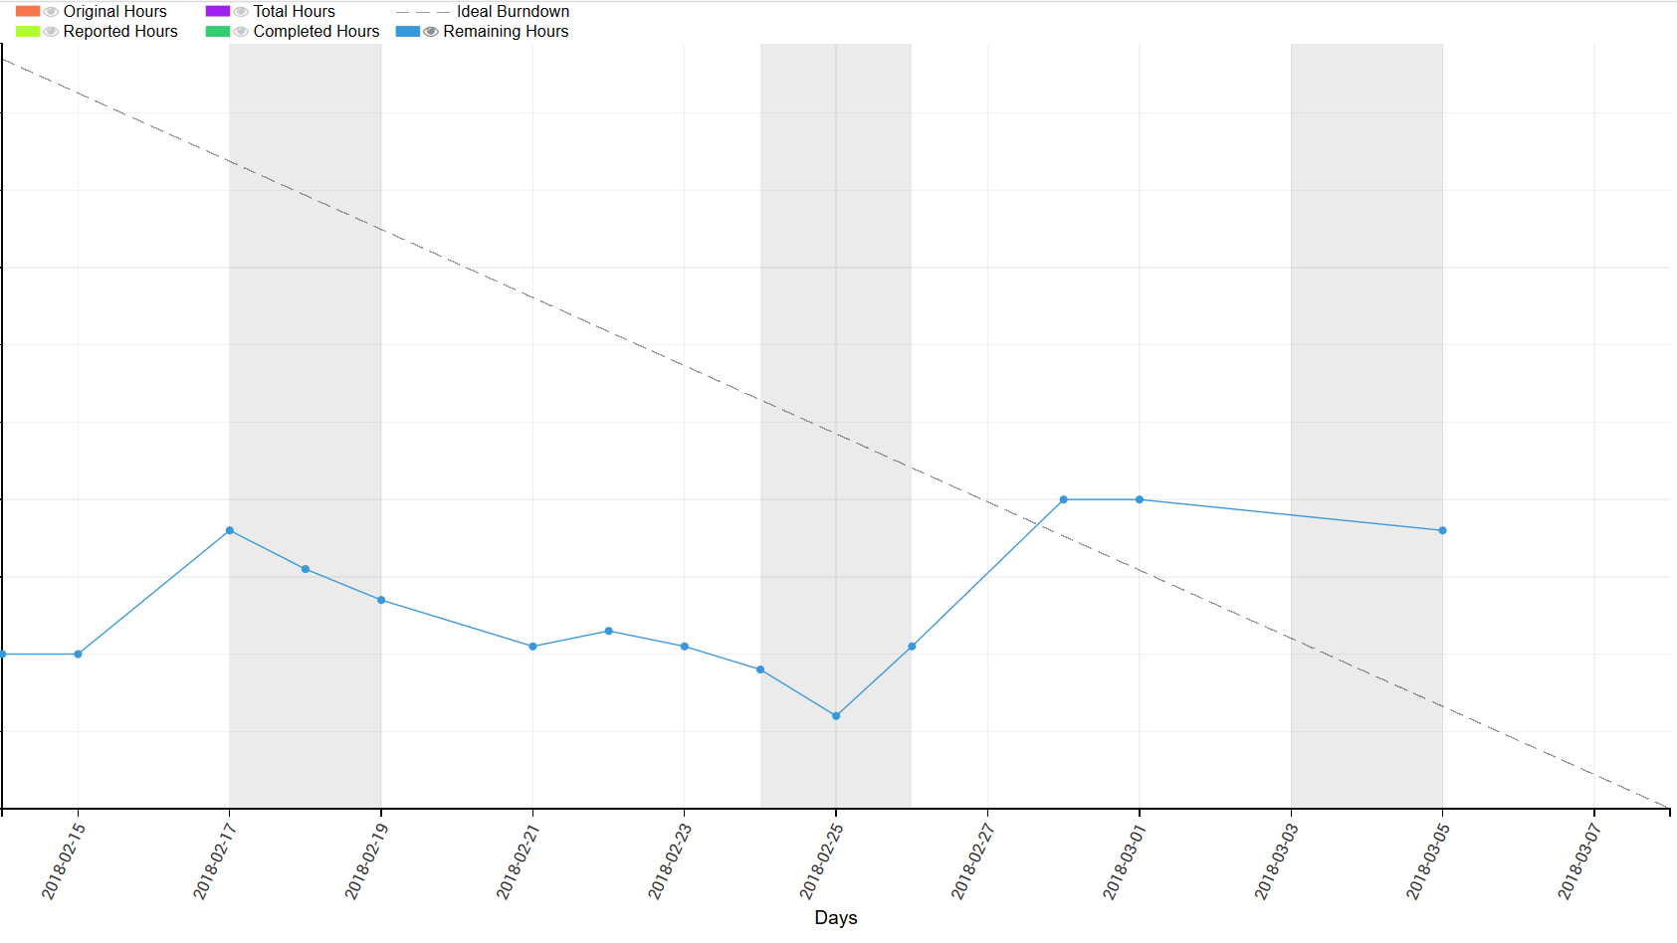

Slide 5
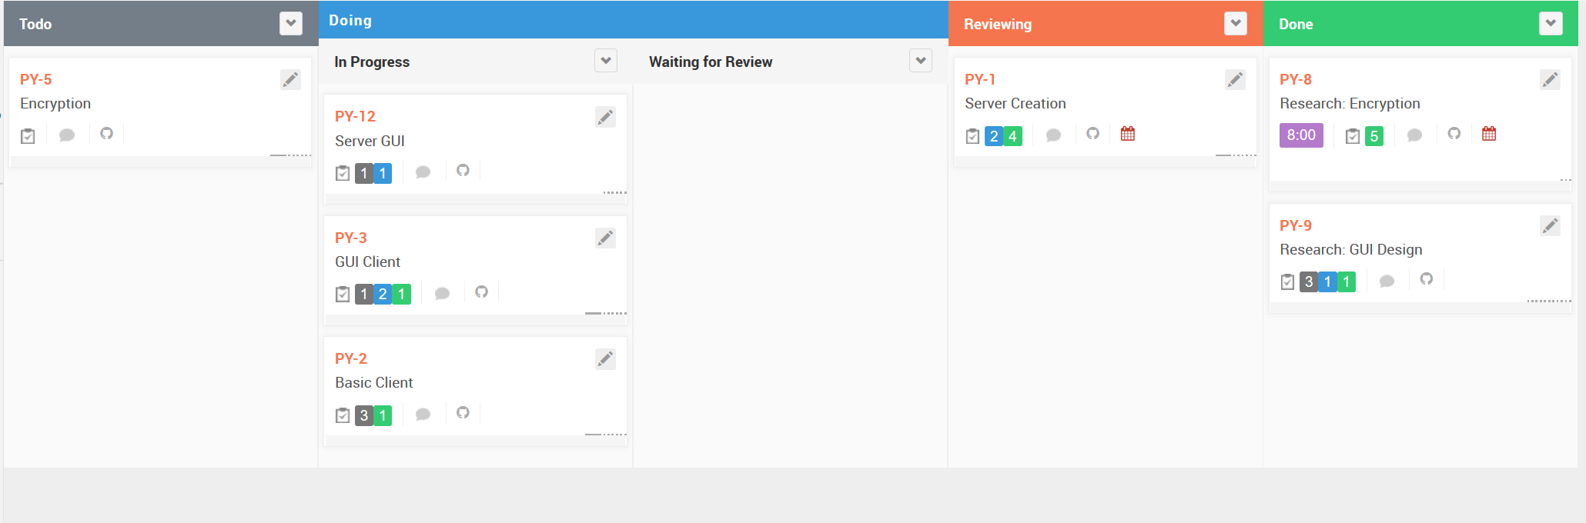

Slide 6
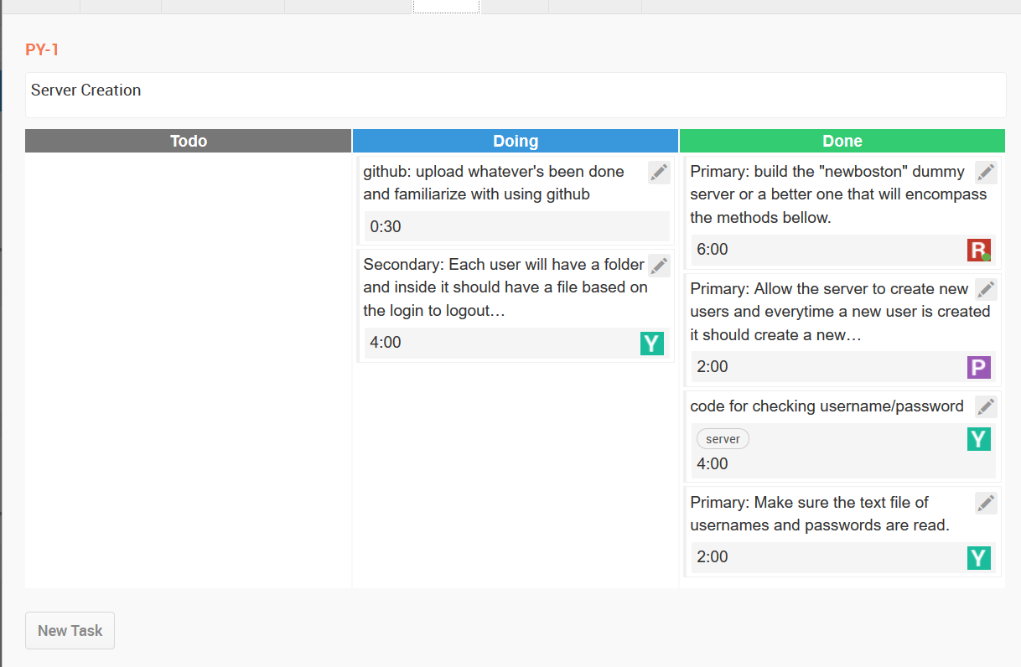

Slide 7
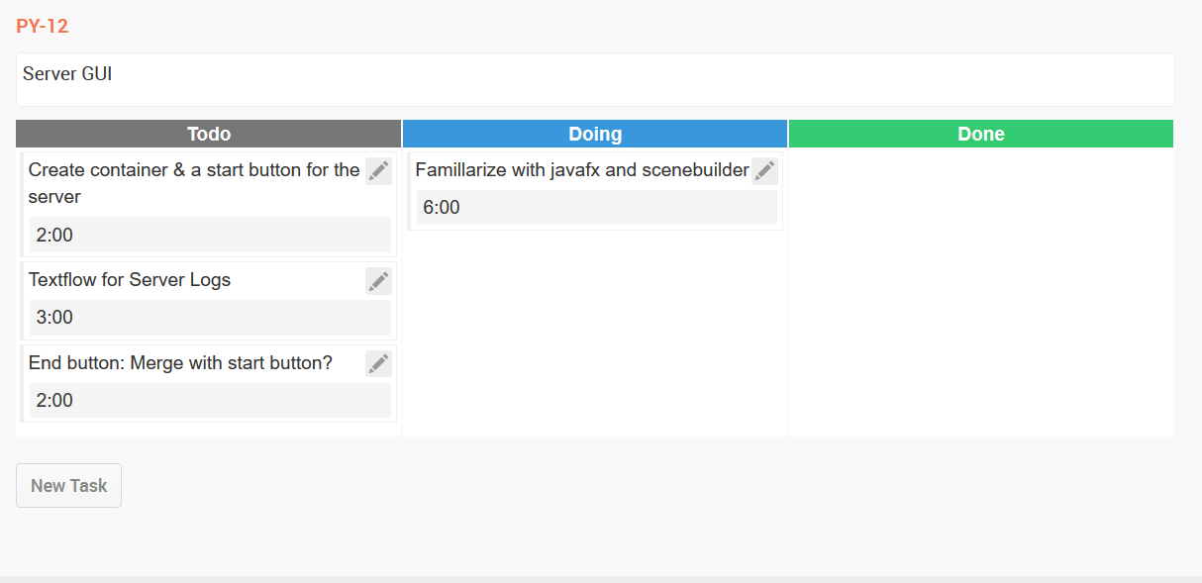
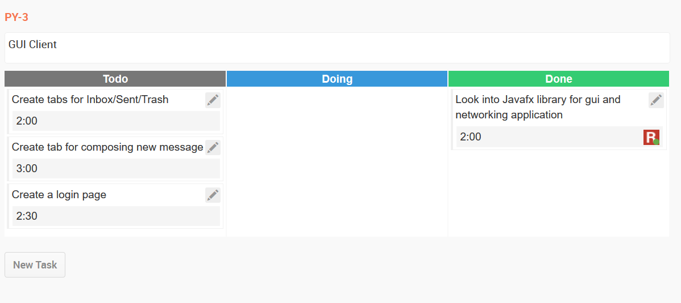
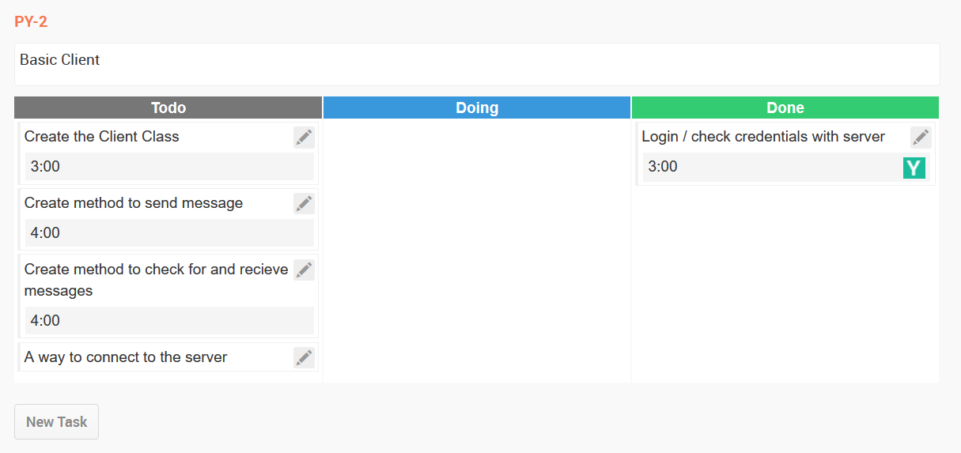

Slide 8
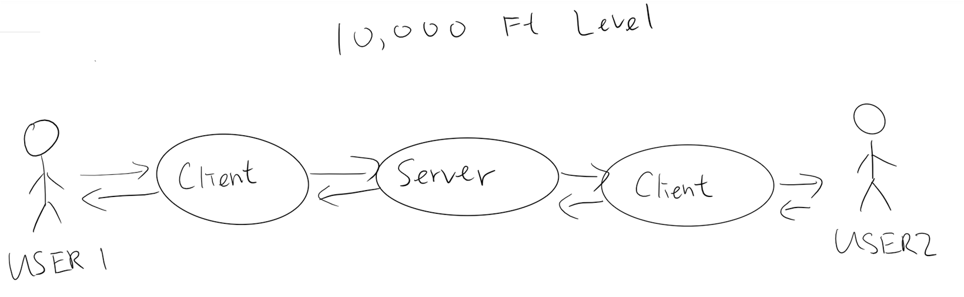
Use Case Diagram

Slide 9
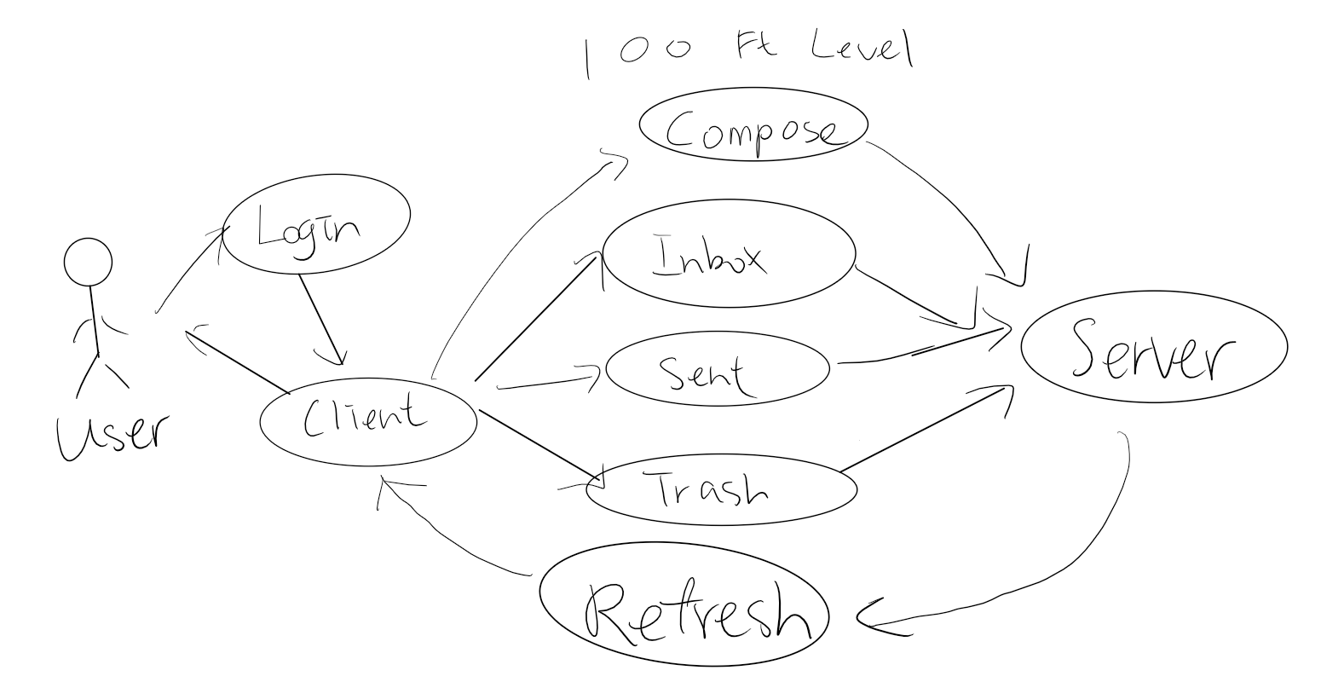
Use case Diagram

Slide 10
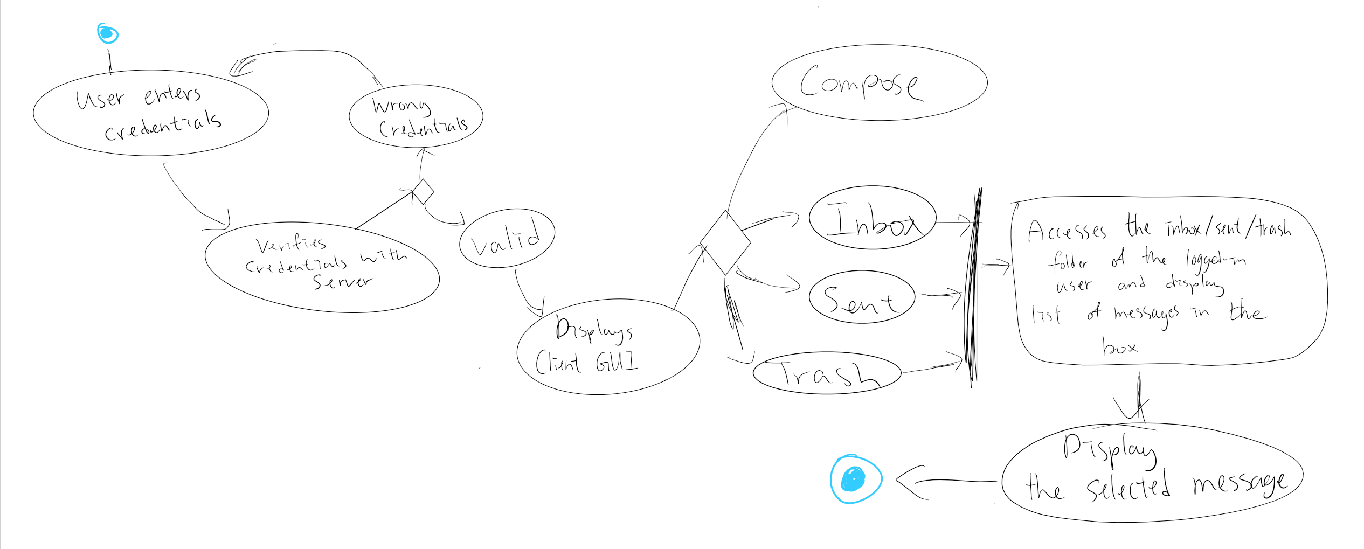
State Diagram (Inbox)

Slide 11
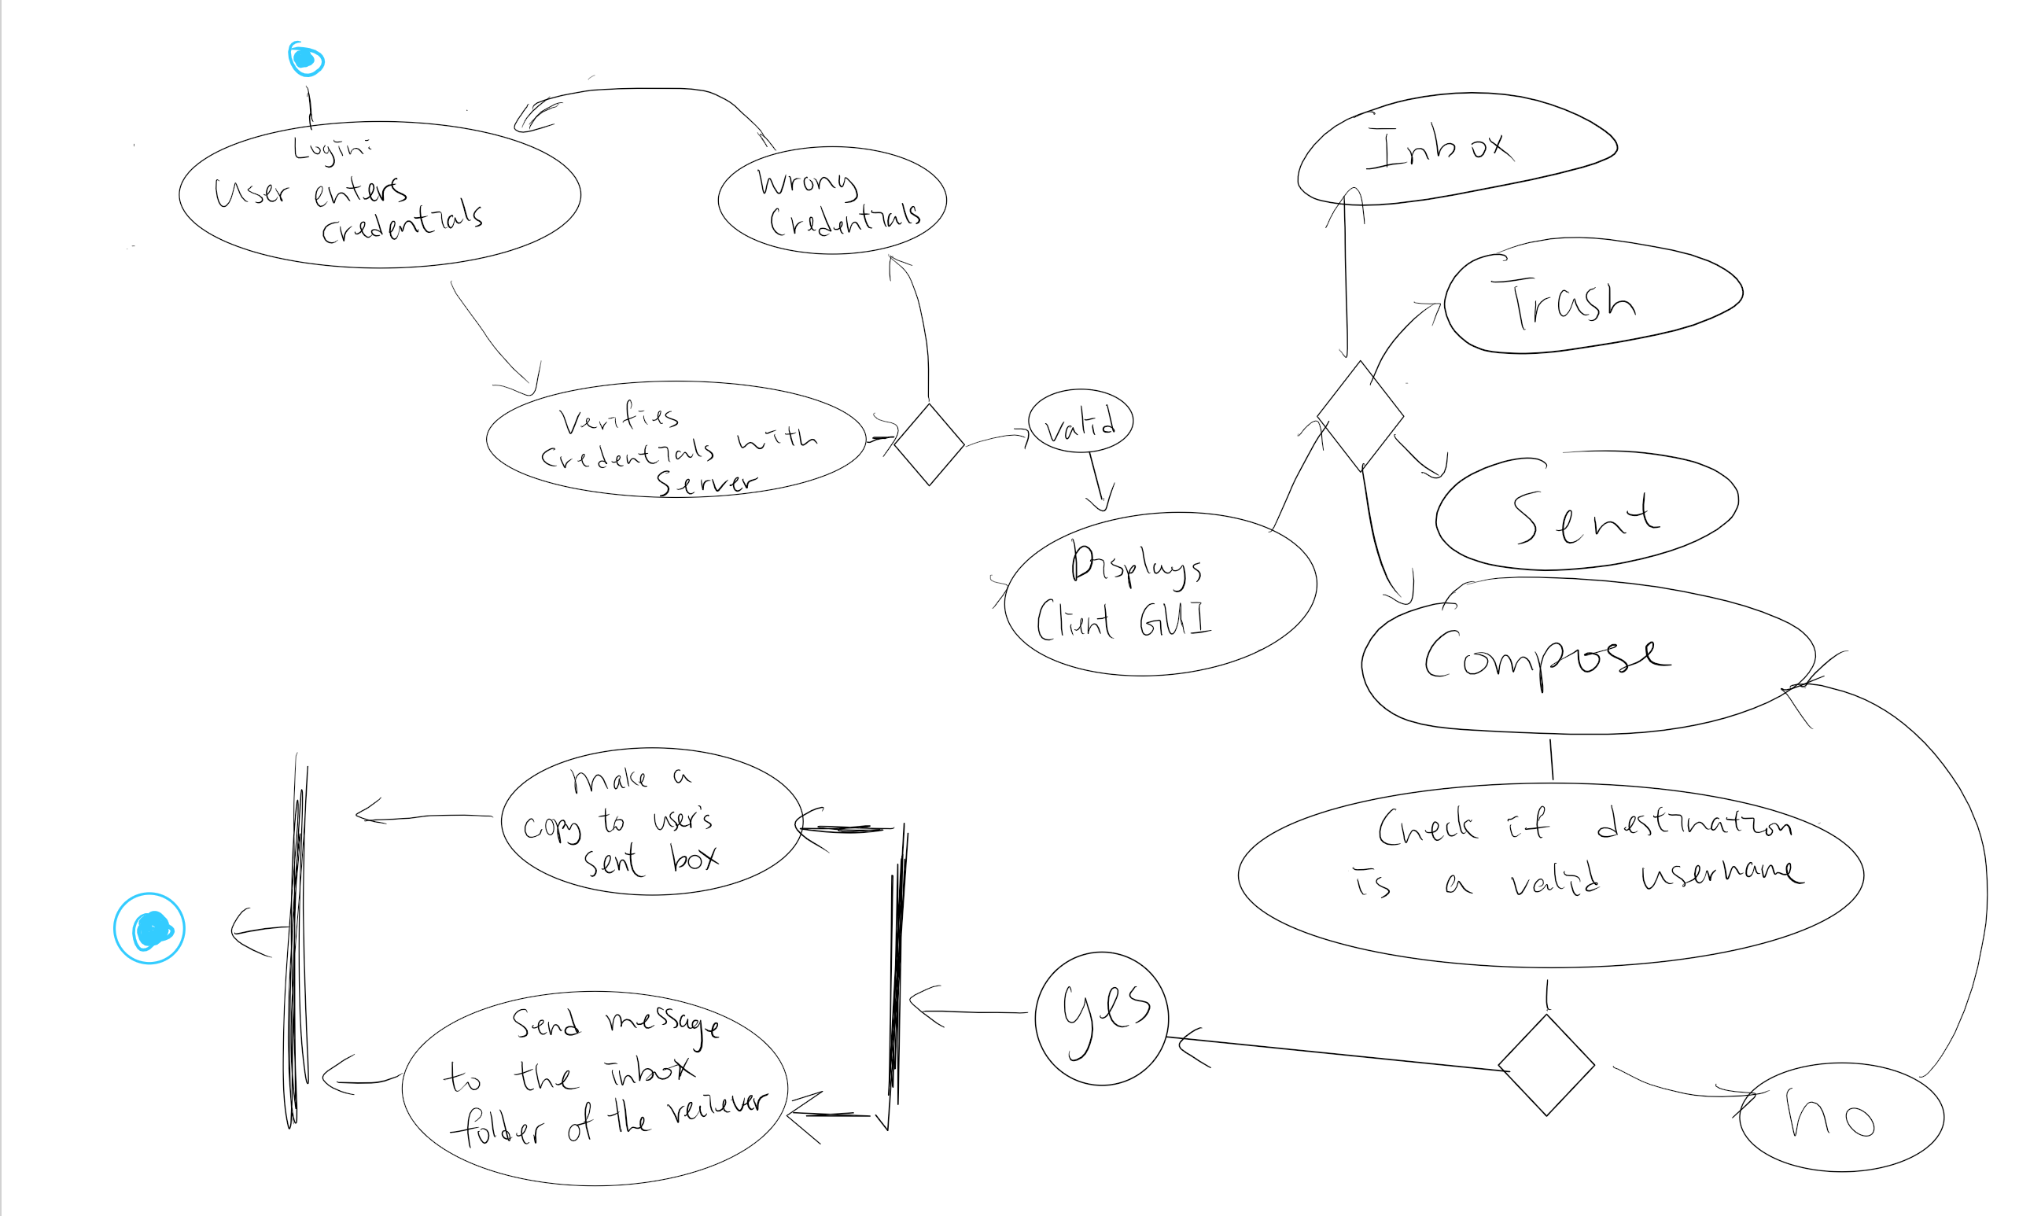
State Diagram (Compose)

Slide 12
The END Thank you!

